Slide 1
Resume Classification
Team 5:
Team members
Rahul M
Abhijit
Muhammed Zayan shareef
Jithin C
Swapnajeet Tripathy
Divya Reddy

Slide 2
Content
Business Objective
Data Summary
Analysis of datasets
EDA
Different Recommendation Model
Challenges

Slide 3
Business Objective
The document classification solution should significantly reduce the manual human effort in the HRM. It should achieve a higher level of accuracy and automation with minimal human intervention
Data summary
Resume Dataset:
It contains Resume folders in doc file, pdf file and docx file :
People soft Resumes
SQL Developer Lightning insight
workday resumes
React JS

Slide 4
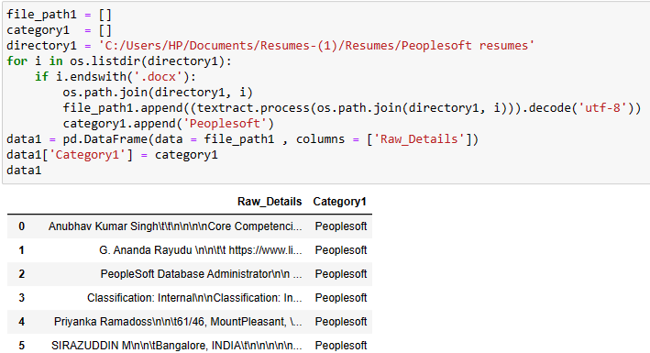
Importing Files
Importing Extracted text from all the Resume files

Slide 5
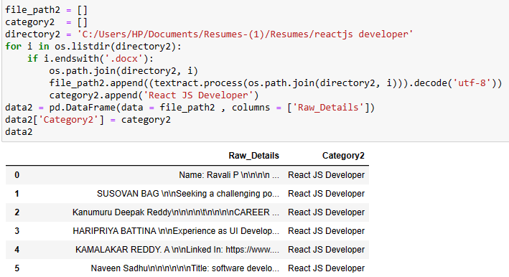
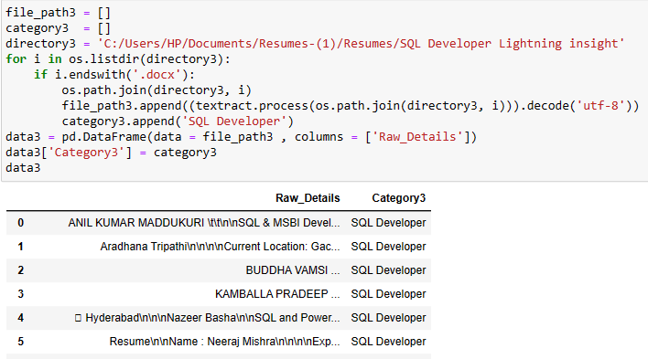

Slide 6
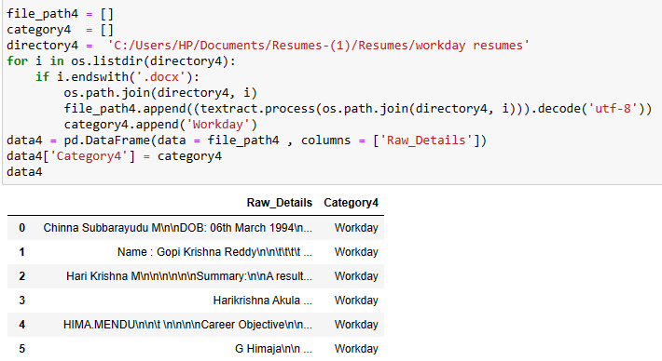

Slide 7
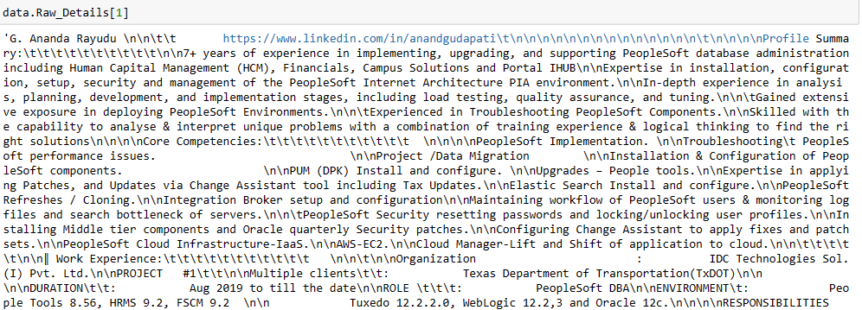
Extracted Text

Slide 8
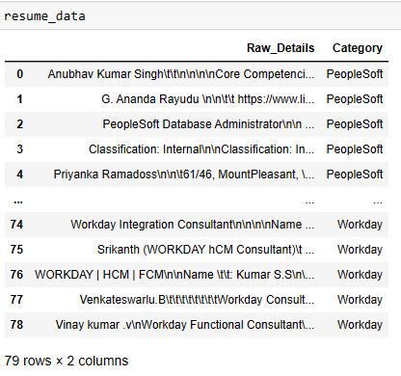
Append all data together and combine all resume category

Slide 9
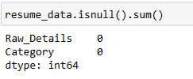
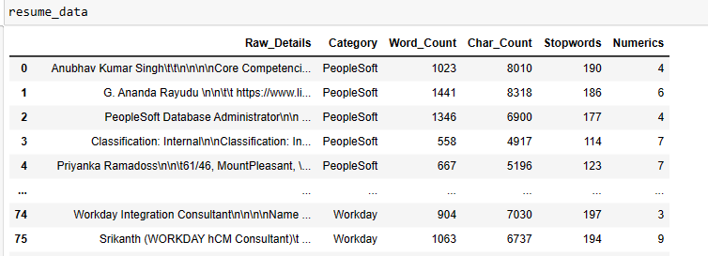
EDA
Checking Null Values
Checking word count, char_count, stopwords, numerics

Slide 10
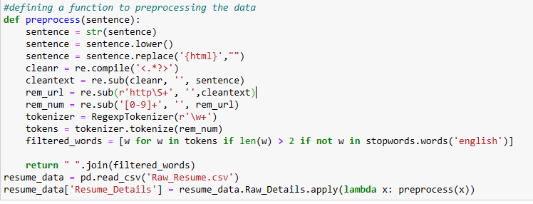
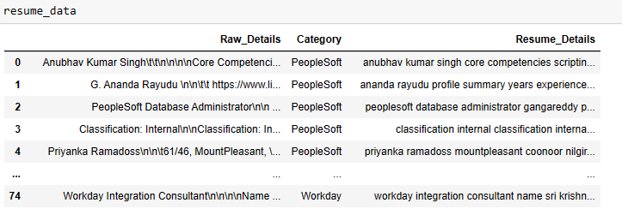
Defining a function to preprocessing the data

Slide 11
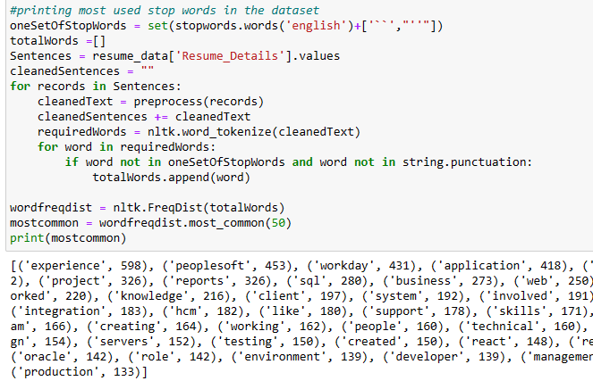
Checking Stopwords

Slide 12
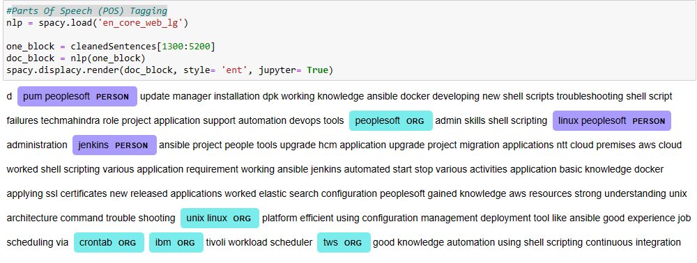
Parts Of Speech (POS) Tagging

Slide 13
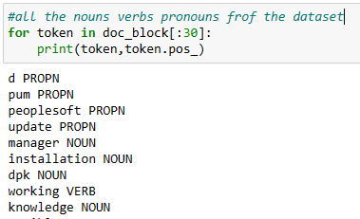
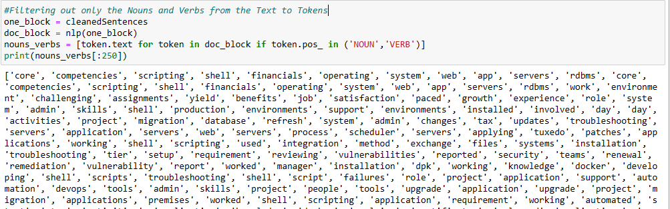
The nouns verbs pronouns from the dataset
Filtering out only the Nouns and Verbs from the Text to Tokens

Slide 14
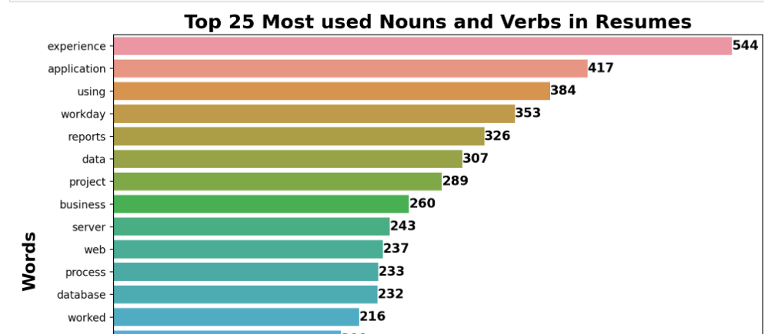
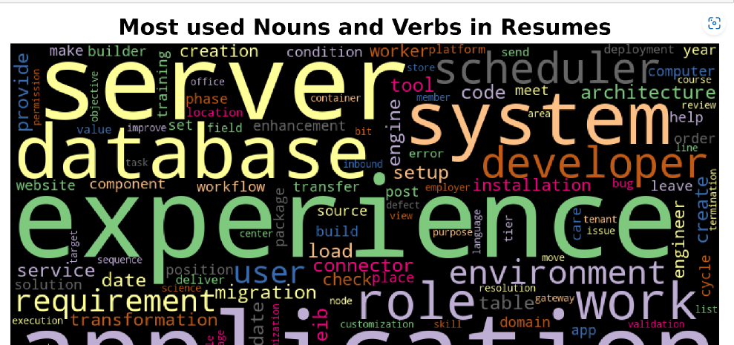
Checking most used verbs and Nouns

Slide 15
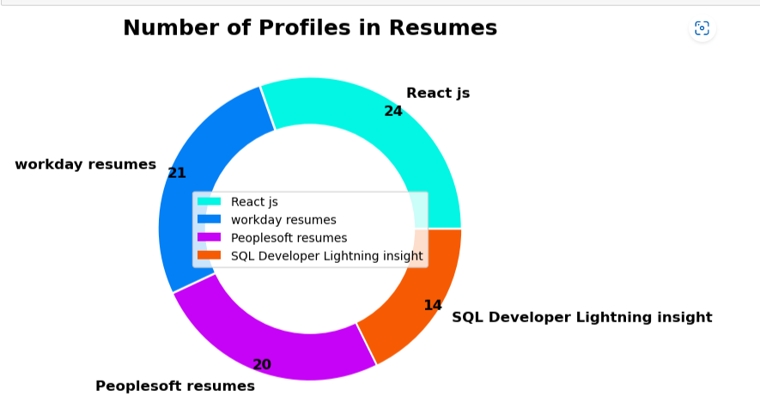
Checking Number of profiles in Resume

Slide 16
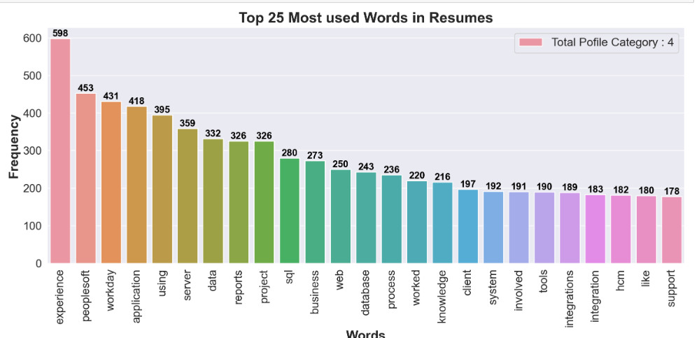
Most used words in Resume

Slide 17
Model Building
Created six Models:
KNN Classifier
Decision Tree Classifier
Random Forest Classifier
Logistic Regression
SVM Classifier
Naive Bayes Classifier

Slide 18
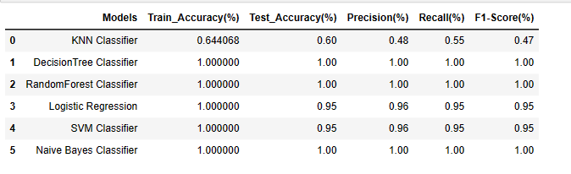
Evaluation
Taken Decision Tree as Model

Slide 19
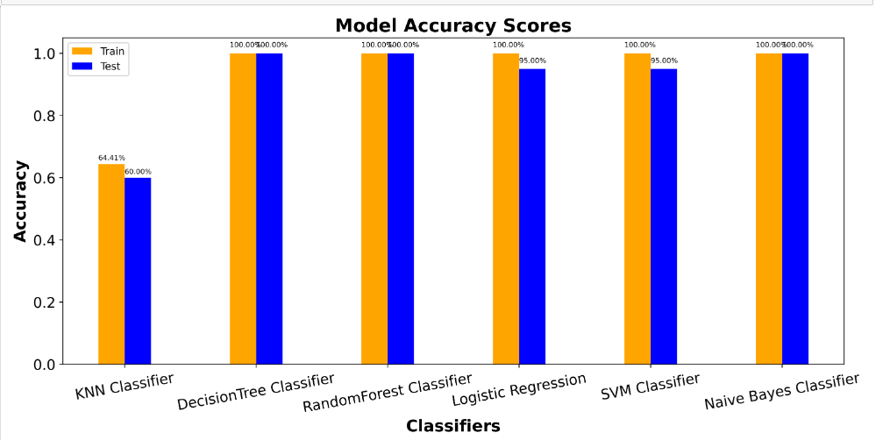
Model Accuracy Scores

Slide 20
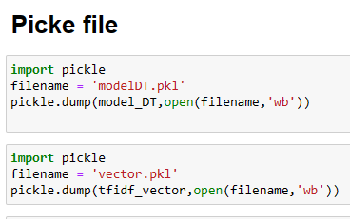
Deployment

Slide 21
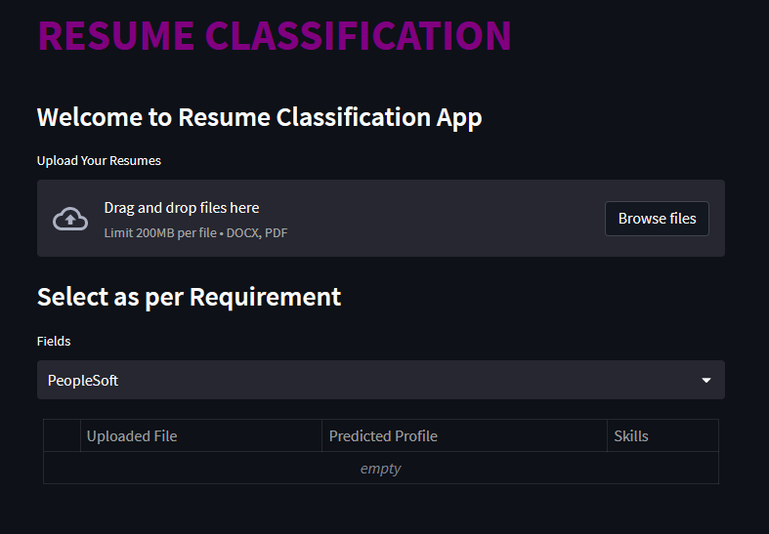

Slide 22
Challenges
Extracting text process is a major challenge as well
Selecting Model is a quiet challenging

Slide 23
Thank You

